Slide 1
DFD Tutorial
FIT – ICT AP
http://www.sqa.org.uk/e-learning/SDM03CD

Slide 2
Mail Order System
You are given the details of a small mail order catalogue system that allows people to shop from home.
When a customer receives the catalogue and wants to buy something, they can telephone, fax or email their order to the company.
The company gets the order and sends the goods and an invoice.
When the customer receives the goods with a delivery note, they send payment and receive a receipt for their payment.

Slide 3
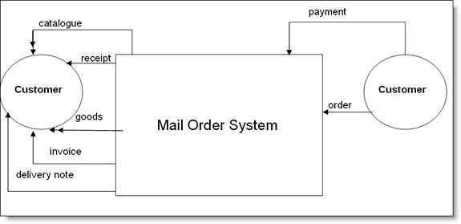
Level 0 Data Flow Diagram / Context Diagram of Mail Order System
You will see that the Customer (a source of information) has sent in an order.
The system has sent out an invoice data flow, a delivery note data flow and goods ('goods' is not information; it is shown as a double-headed arrow because it is a physical or resource data flow).
Payment comes in - ie a payment data flow is received, and a receipt data flow goes out to the customer.
Catalogue goes out to the customer - this is also a physical data flow.
We now have a top-level view of the information flow in and out of the system.

Slide 4
Exercise
When a patient arrives at Mosspark Surgery with a repeat prescription request, the receptionist checks the prescription file and writes out a prescription.
This has to be authorised by the doctor before being passed to the resident chemist for dispensing.
The chemist then gives the prescription to the patient. If the patient is entitled to free prescriptions, the chemist verifies this and fills in the appropriate details on a form, which is filed in the free prescriptions file.
Otherwise the chemist takes the appropriate amount of money from the patient and gives them a receipt.

Slide 5
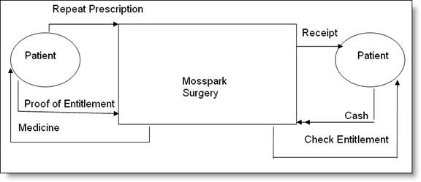
Level 0 Data Flow Diagram / Context Diagram of Moss Park Surgery

Slide 6
Next: Create a Level 1 DFD
The next stage is to create the Level 1 Data Flow Diagram. This highlights the main functions carried out by the system.
As a rule, we try to describe the system using between two and seven functions - two being a simple system and seven being a complicated system.
This enables us to keep the model manageable on screen or paper.

Slide 7
Exercise
Try to describe what the mail-order system does in a number (two to seven) of short sentences - these sentences become the system's functions. Let's describe the system in two sentences.

Slide 8
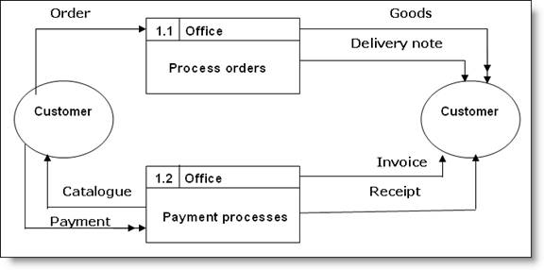
Level 1 Data Flow Diagram?
Gets orders from customers and receives payment when they are delivered.
We can show this as a Level 1 DFD:
Note that the data flows from the Level 0 DFD are attached to the correct Level 1 function.

Slide 9
Level 1 Validation…
There are certain rules we must check in order to ensure that we create a valid DFD.
Rule 1 - Does each function have input and output?
Rule 2 - Does each function have all the information it needs in order to produce its output?
Rule 3 - If not, then what information does it need and where will it get that information from?

Slide 10
Validation Results
Applying these simple rules ensures a valid Data Flow Model. So let us apply these rules to our Level 1 DFD.
Rule 1: Answer YES.
Rule 2: Function 1: YES - it does have all the information it needs. It only needs order details to produce its output - invoice.
Function 2: NO - it does not have all the information it needs to produce its output (receipt). So we must apply Rule 3 to Function 2.
Rule 3: Function 2 has payment details but it also needs order details so that it can match up payment with order. So where will it get information from? We can see that Function 1 receives order details from the customer, so it must receive order details from Function 1.

Slide 11
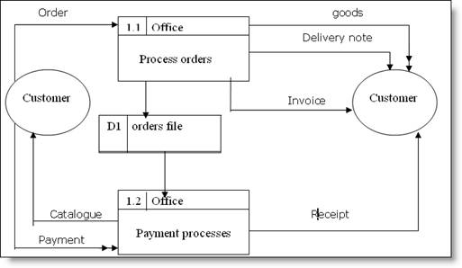
Level 1 Data Flow Diagram
How do we show this in our DFD?
→ We can assume that Function 1 stores order details. This is shown on the below:
We have used the data store symbol to show the stored orders.
Note that Function 1 creates the order data store and Function 2 reads the data store.
Note also how important it is to apply all the rules - if we only applied the main rule (ie all functions to input and output), the diagram would have been incomplete.

Slide 12
Data Flow Diagrams In a Nutshell…
Process – An activity or a function that is performed for some specific reason; can be manual or computerized; ultimately each process should perform only one activity
Data Flow – single piece of data or logical collection of information like a bill
Data Store – collection of data that is permanently stored
External Entity – A person, organization, or system that is external to the system but interacts with it
Basic rules for Process Modeling:
A series of data flows always starts or ends at an external agent and starts or ends at a data store. Conversely, this means that a series of data flows can not start or end at a process.
A process must have both data inflows and outflows.
All data flows must be labeled with the precise data that is being exchanged.
Process names should start with a verb and end with a noun.
Data flows are named as descriptive nouns.
A data store must have at least one data inflow.
A data flow can not go between an external agent and a data store, but a process must be in between.
A data flow can not go between two external agents, but a process must be in between.
A data flow can not go between two data stores, but a process must be in between.
External agents and data flows can be repeated on a process model in order to avoid lines crossing, but do not repeat processes.

